Slide 1
UI Design parts for Low Fidelity prototyping

Slide 2
Device Frame

Slide 3

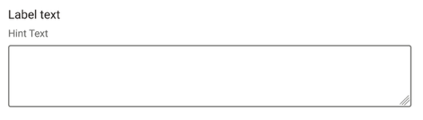
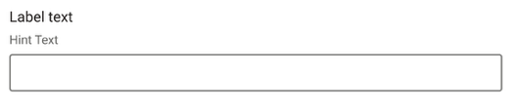

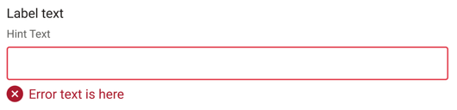
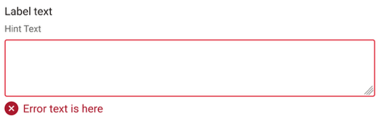
UI parts: Link, Text Input, Text Area
 | Link | Text Input | Text Area
Low Fi | Link
Design System
Label text
Hint Text
Label text
Hint Text
Error Text
Error Text
*The design system parts might not be the latest version.

Slide 4


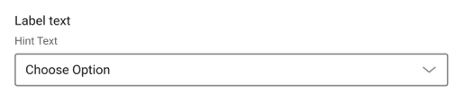
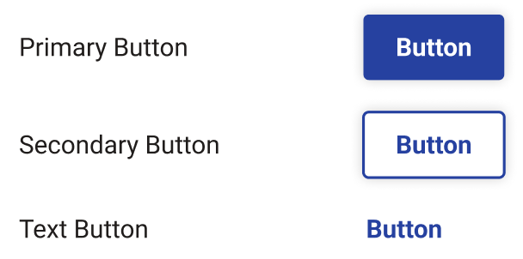

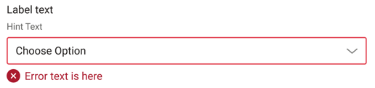
UI parts: Select, Button, Search
 | Select | Button | Search
Low Fi
Design System
Label text
Hint Text
Button
Choose Option
Button
Error Text
Button
*The design system parts might not be the latest version.

Slide 5


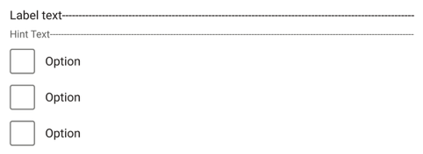
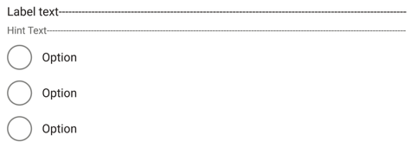

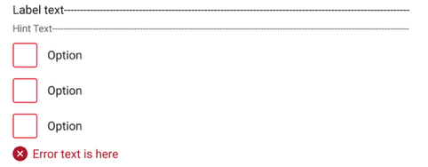

UI parts: Checkbox, Radio, Spinner
 | Checkbox | Radio | Spinner
Low Fi
Design System
Label text
Hint Text
Label text
Hint Text
Option
Option
Option
Option
Option
Option
Label text
Error Text
Error Text
*The design system parts might not be the latest version.

Slide 6

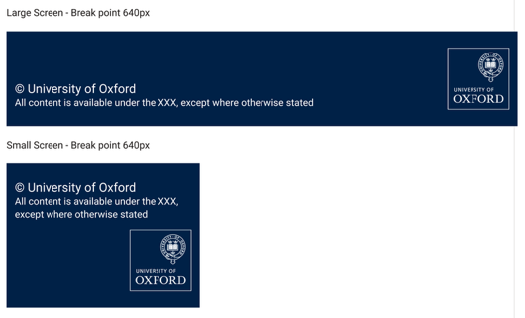
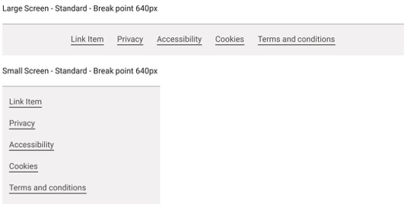
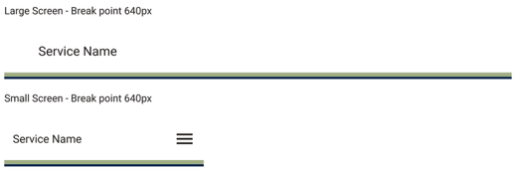
UI parts: Header, Footer, Footer Navigation
 | Header | Footer | Footer Navigation
Low Fi
Design System
Privacy
Accessibility
Cookies
Terms
Service Name
© University of Oxford
Privacy
Service Name
© University of Oxford
Accessibility
Cookies
Terms
*The design system parts might not be the latest version.

Slide 7

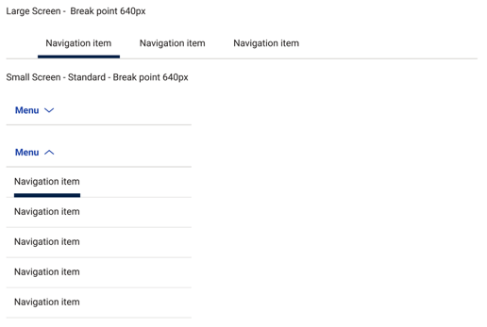

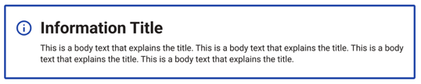
UI parts: Pagination, Navigation, Section Message
 | Pagination | Navigation | Section Message
Low Fi
Design System
Navigation Item
Navigation Item
Navigation Item
Menu
Information Title
< Previous
1
2
3
4
5
Next >
Menu
This is a body text that explains the title.
Navigation Item
Navigation Item
Navigation Item
*The design system parts might not be the latest version.

Slide 8
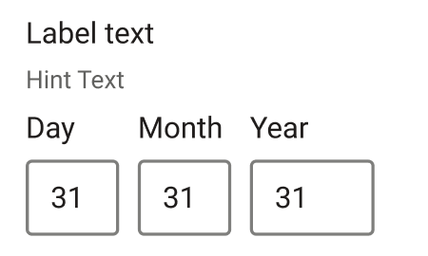
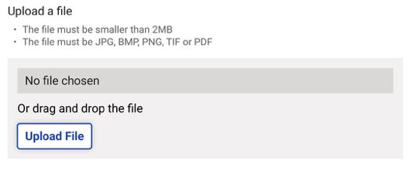

UI parts: Tag, File Upload, Date Input
 | Tag | File Upload | Date Input
Low Fi
Design System
Upload a file
Label text
Hint Text
Tag Name
Day
Month
Year
Upload File
*The design system parts might not be the latest version.

Slide 9










Icons
*The design system parts might not be the latest version.

Slide 10
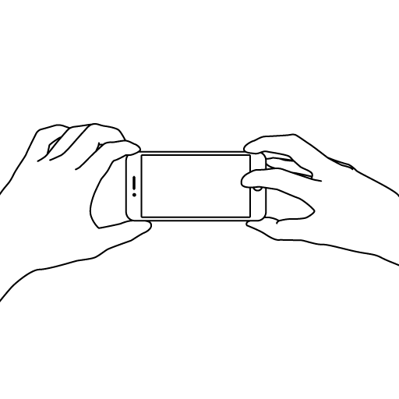
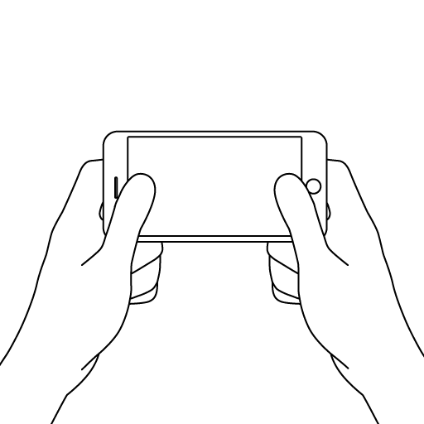
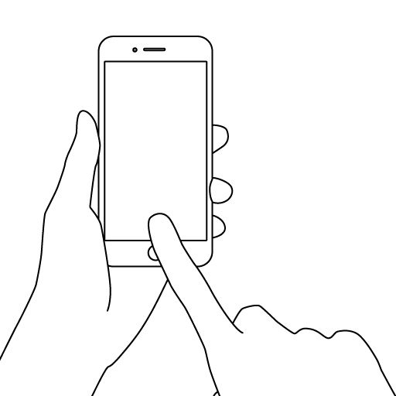
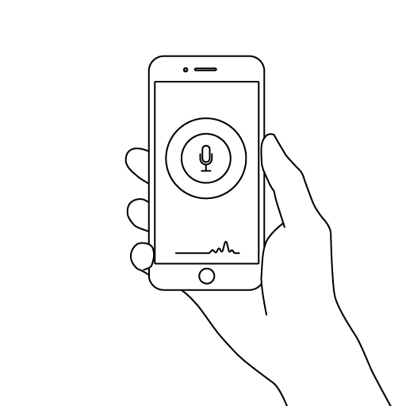
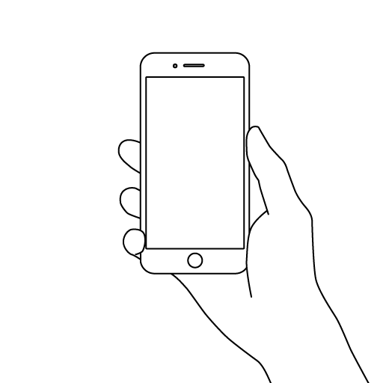
Mobile in use illustrations

Slide 11
Low Fi prototype mobile template

Slide 12
Low Fi prototyping PC template

Slide 13
User Story board comic panel template

Slide 14
Examples

Slide 15




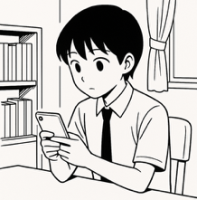
COURSE ID
History-12345
1
Users can find a set of books for the course by searching with the course name
You can find a set of books for your course!
University library
University library
Book Search
Title
History-12345 book set
Select All
Loan
Course ID
History study fundamentals
More info >
Search
Loan
Only a few clicks to organise my readings!
Evidence Based Research Method
COURSE
RESUME
More info >
University library
Loan
Search Result
Course ID: History-12345
History-12345 book set

Slide 16





A low Fi prototype to express the idea that users can choose a book just like choosing a record in a record shop
2
Users can choose a book just like choosing a record in a record shop
Summer
Book
Summer
Book
Yamada Taro
Summer Book
Yamada Taro
Published: 2015
Publisher: Africa Books

Slide 17




A comic style story board to express the idea that a user can send a message to the user who is loaning the book after the return date
3
A user can send a message to the user who is loaning the book after the return date
I need to check Smith’s book for the conference!
University library
Lung Cancer loaner
Search Result
Hello, I’m researching lung cancer and need this book for a conference in two weeks. Could you please return this book as soon as possible?
Lung Cancer
James Smith
Not available
Return due date: July 20, 2025
University library
Loan
Book Search
Message to the current loaner
Sorry, I will return it tomorrow!
Title
Oh No!
Lung Cancer
Author
James Smith
I got the book!
Search

