Slide 1
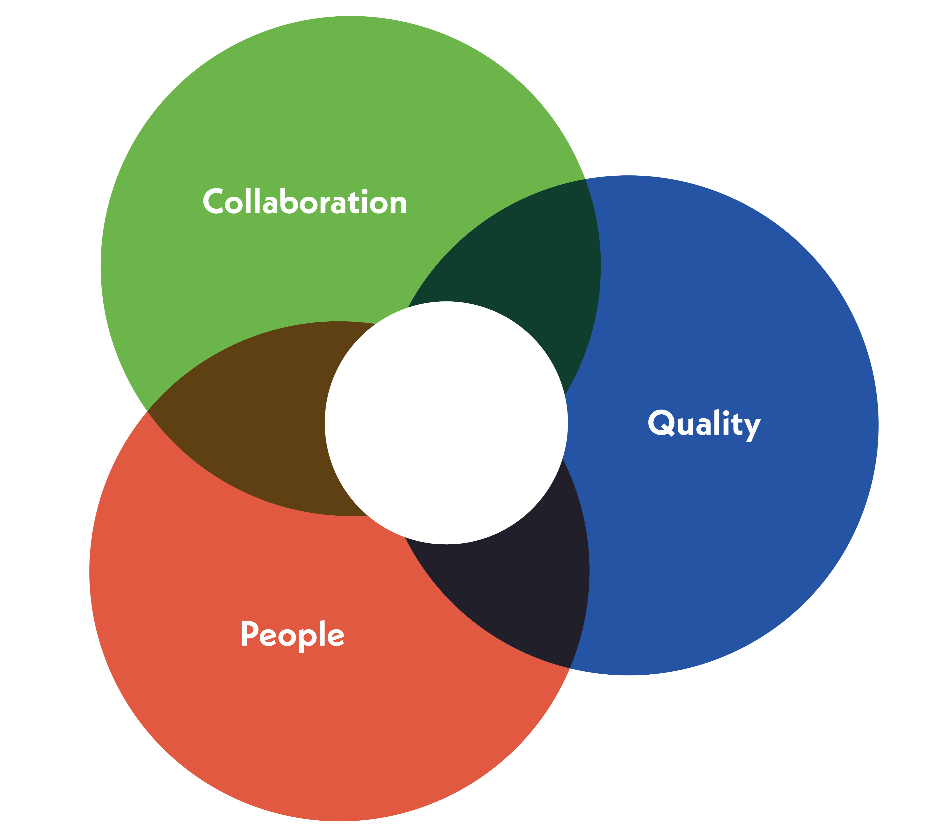
Team discussion guide Professional communities: an introduction
Collaboration
It’s amazing what can happen when we work together. Professional Services Together is making things easier and better for Oxford’s professional services staff, and everyone else. Supporting us in continuing to improve our processes, share brilliant ideas and better understand each other’s perspectives.
This pack is an introduction to professional communities at Oxford, giving you some opportunities to discuss at a team meeting and to then action.
Quality
People
Published: Michaelmas term 2023

Slide 2
How to use this pack
For managers
For team members
Share the pack in advance with your team, encouraging them to review the material
Add this as an item to your team meeting to discuss further
Encourage discussion and listen to your team's ideas and feedback
Take time to read the material and follow the links to find out more
Think about how the professional communities could benefit you individually and as a team
Bring your ideas to the team meeting and discuss

Slide 3
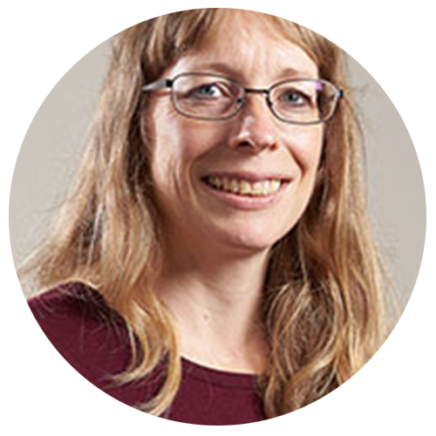
What is a professional community?
Professional communities are formed by colleagues who work in similar roles or share similar interests. At Oxford, professional communities are known by a range of names including networks, forums or Communities of Practice (CoPs).
They are spaces where you can:
"What the group started from, and has always enjoyed the most, is the back-and-forth query and solution which we all help each other with on a daily basis"
Lucy Curtin, Executive Assistant and founder of the EA & PA CoP
Enhance your skill set
Build relationships
Work together to address common challenges
Share knowledge
Connect and collaborate across Oxford
Learn from each other
Develop your career

Slide 4
What's in it for me?
As a member of a professional community at Oxford so many opportunities are open to you:
Strengthen a
shared identity and sense of belonging as part of your profession and within Oxford
Solve common problems
Innovate
Career pathways
Test ideas
Recognition and support from colleagues at all levels and beyond your profession
Training sessions
Stretch your
skill set by working on profession or University-wide projects
Share best practice and learn from others
Grow your skills and experience
Remove barriers
Knowledge directories
Get peer support
Make connections for current and future roles
Access to senior leaders

Slide 5
What difference does it make?
The EA & PA Community of Practice is a 250+ member-strong community which has:
Established a thriving Teams site to share resources and knowledge
Developed a comprehensive ‘Who’s Who’ list of contacts, shared tips for solving common issues, and a ‘Happy to Help’ list of member's expertise
Embraced a continuous learning and incremental development approach through monthly 'Lunch and Learn' sessions and an annual conference – taking small steps which are leading to wider changes
Won a national award for 'Internal Team of the Year' from the Strategic PA Network
Looking to the future, the CoP is working on creating a career development framework for EAs and PAs at Oxford as part of Professional Services Together’s focus on Oxford-wide Careers.
The Business Continuity Network is a thriving community with membership from across the collegiate University. The community:
Provides business continuity direction, guidance and supports the delivery and day-to-day management of business continuity planning
Meets monthly for a summary of potential threats
Shares lessons from recent disruptions
Runs exercises to test the University's business continuity plans

Slide 6
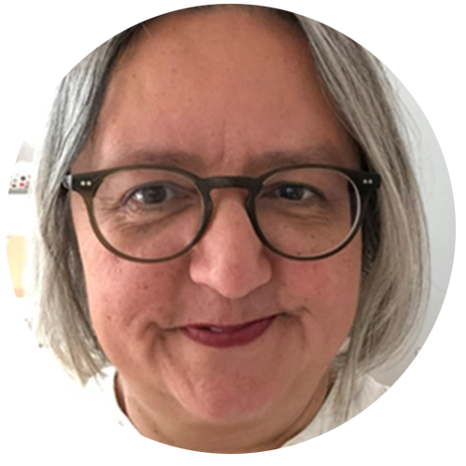
Pick one or two questions to discuss at your meeting
Is anyone in the team a member of a professional community? If so, what are the benefits from your perspective? How has this helped your work or skills development?
What have you learnt from your membership of a professional community that has made the biggest impact on your work?
How can we make a difference to our profession through Community of Practice projects?
“It is a very real pleasure to offer my support in signalling the importance and value of the work of the Education Administration CoP."
Dr Saira Shaikh, Academic Registrar and sponsor Education Administration CoP

Slide 7
Next steps
Find existing professional communities at Oxford and beyond by visiting the connecting with people webpage
Join an existing community for your profession and/or interest areas
Contact the People and Organisational Development (POD) team to get your network or Community of Practice added to the connecting with people webpage if it's not already listed
Taking it further
The POD team has developed toolkits for both emerging and existing professional communities providing helpful resources, stories and guidance. Read the professional networks toolkit and the Communities of Practice toolkit to explore what's available.
If you have any questions about professional communities at Oxford, please contact People and Organisational Development (POD) team by emailing: pod@admin.ox.ac.uk

Slide 8
Professional Services Together
We work together as one proactive, confident, inclusive, and effective team that collaborates across the University.
We are committed to understanding the needs of all parts of the University and aim to continually improve quality and efficiency of our services.
We nurture, develop and respect our people, celebrate success and are respected for our highly professional approach.
www.ox.ac.uk/together

